Slide 1
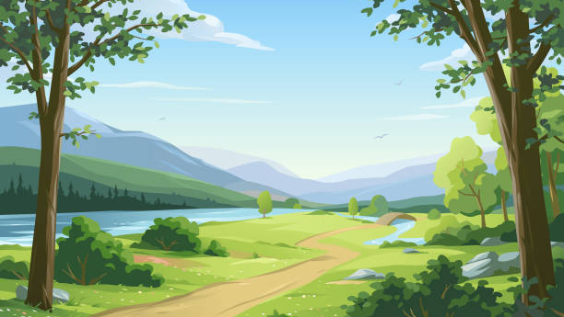
Blueberry Peak
Xaver Drabik • Sofiia-Khrystyna Borysiuk • Florian Kraushofer • Florian Schmid

Slide 2
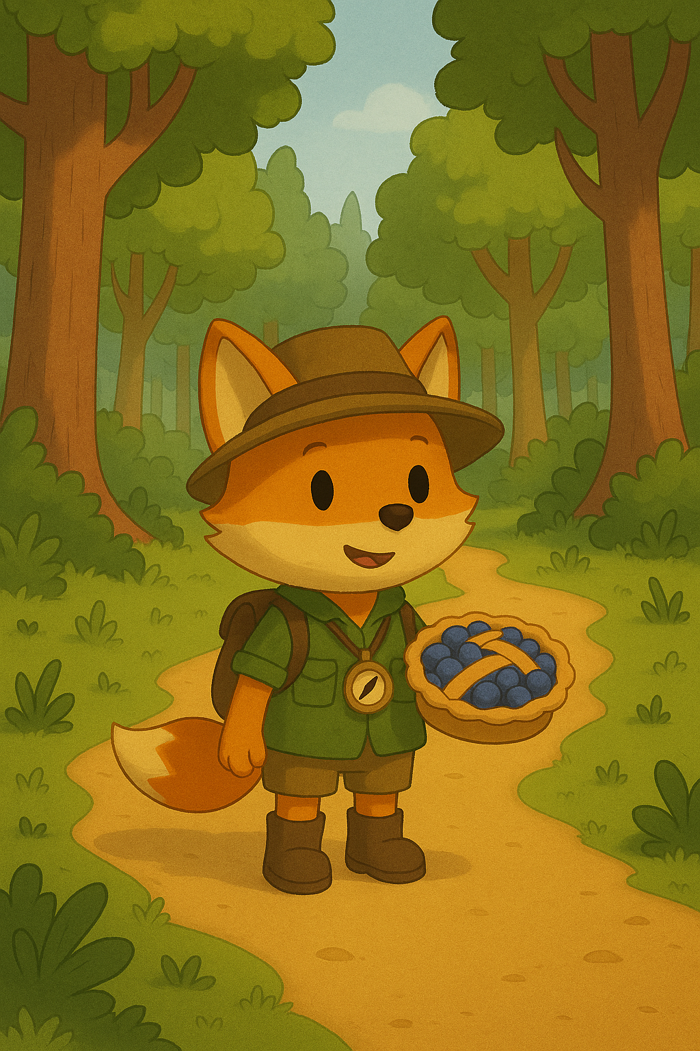
Introduction & Motivation
CCLs are stressful, therefore we want to create fun, relaxing and once upon a time a polished game :)
You play as Luna, a fox that loves Mr. Smith's Blueberry Pie. After your Mother told you, that he is retiring you are going on a moderately paced walk to his baking shop on top of the hill. Along the way you encounter some challenges that require you to use your wits and foxy senses to overcome obstacles and gather ingredients for a farewell pie.

Slide 3
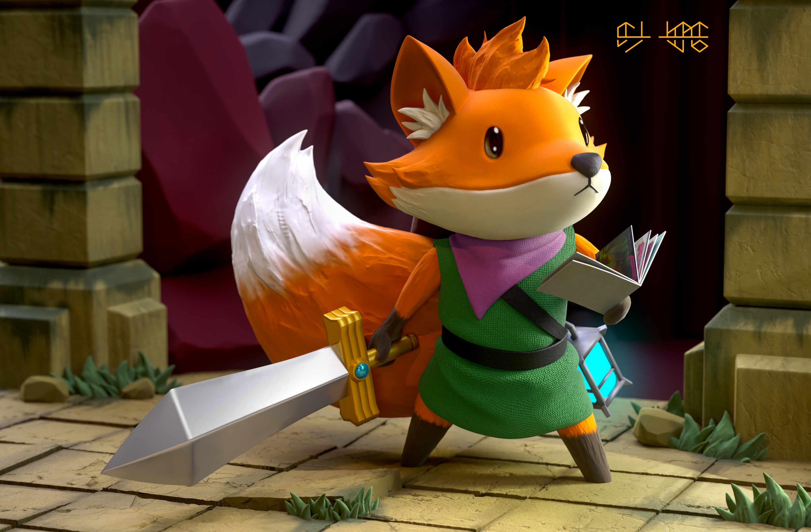
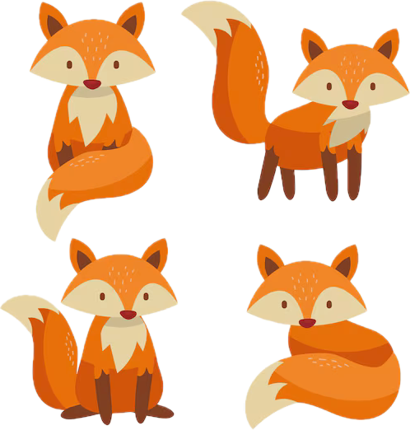
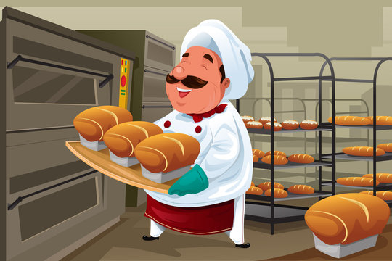
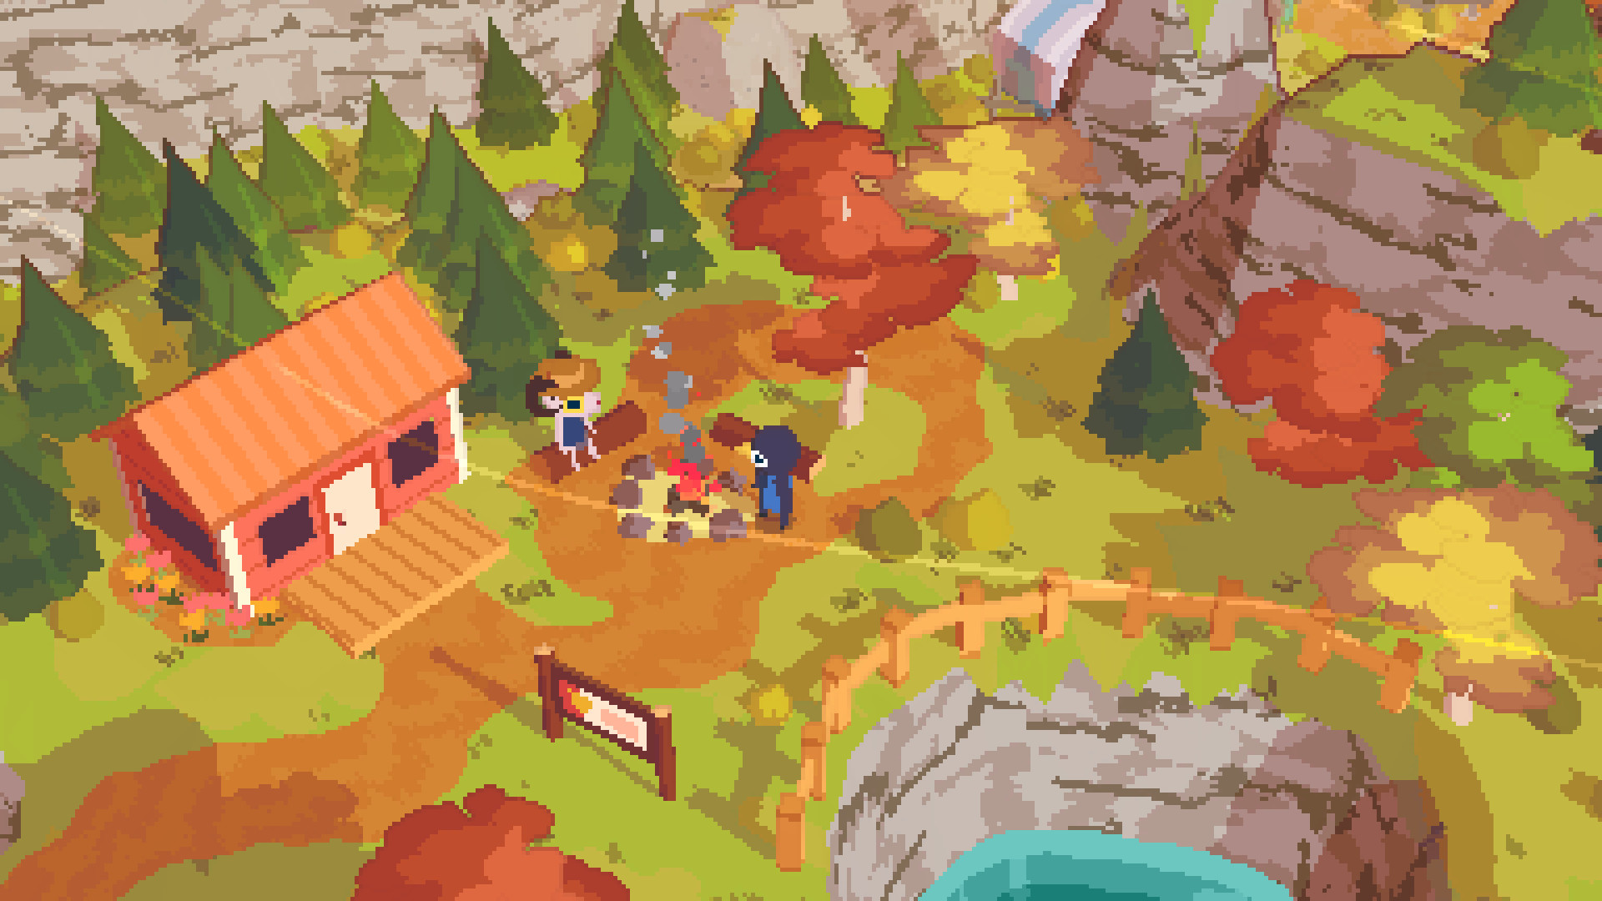
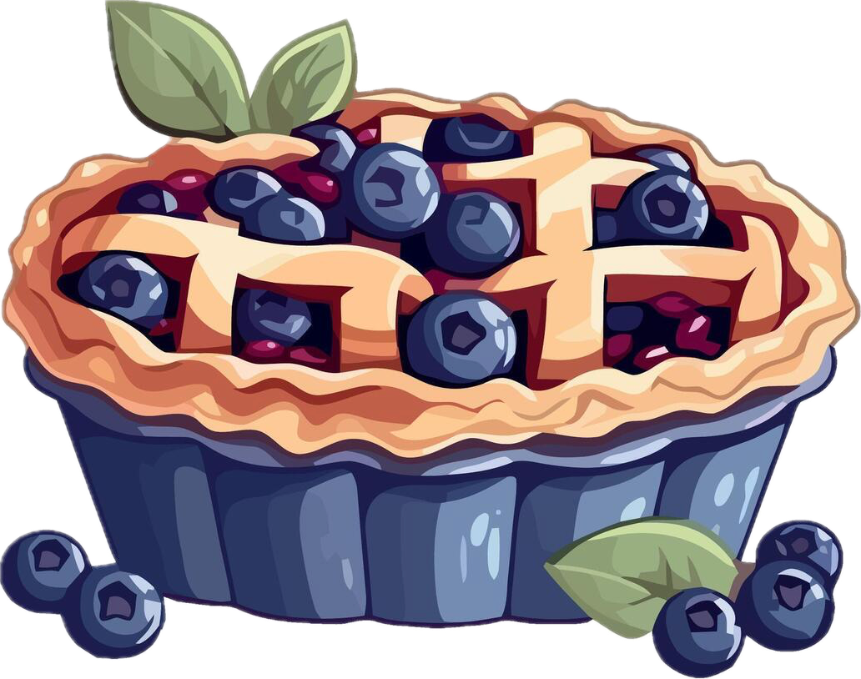
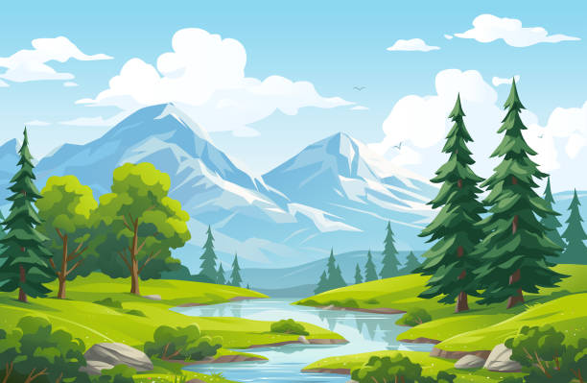
Moodboard

Slide 4
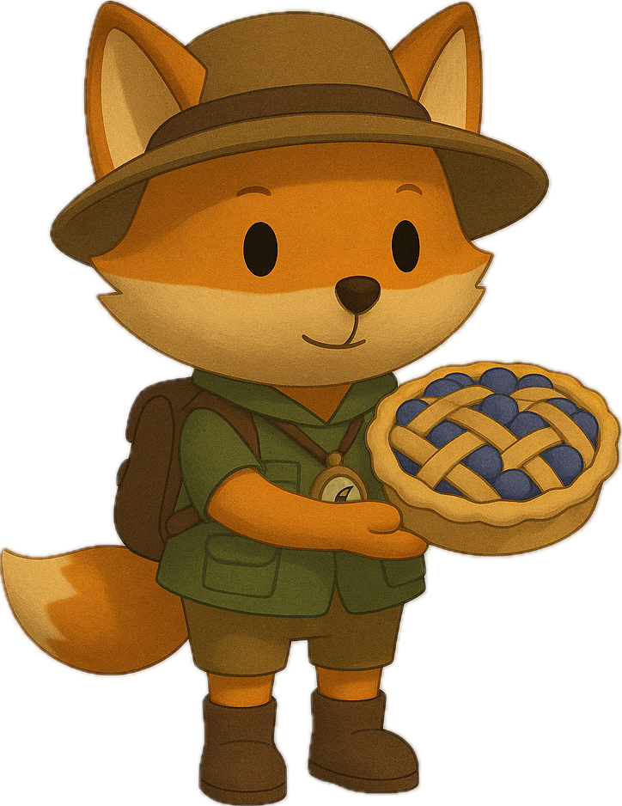
3D Modeling and Animation
﻿﻿Main Character --> Fox
﻿Animations: idle, walking, talking, jumping, interaction with objects
Other characters:
Mom Fox
Baker
Side characters that give small riddles
Animations: idle, talking
Scene Props:
Bakery, bushes, house, trees, berries, etc

Slide 5
﻿﻿Game Audio
Wwise for audio implementation
3D Sounds:
Environment (Water, Birds....)
Wind
NPC Actions
2D Sounds:
Walking/steps
Talking with NPCs
Interacting with items/objects
Background Music
User Interface

Slide 6
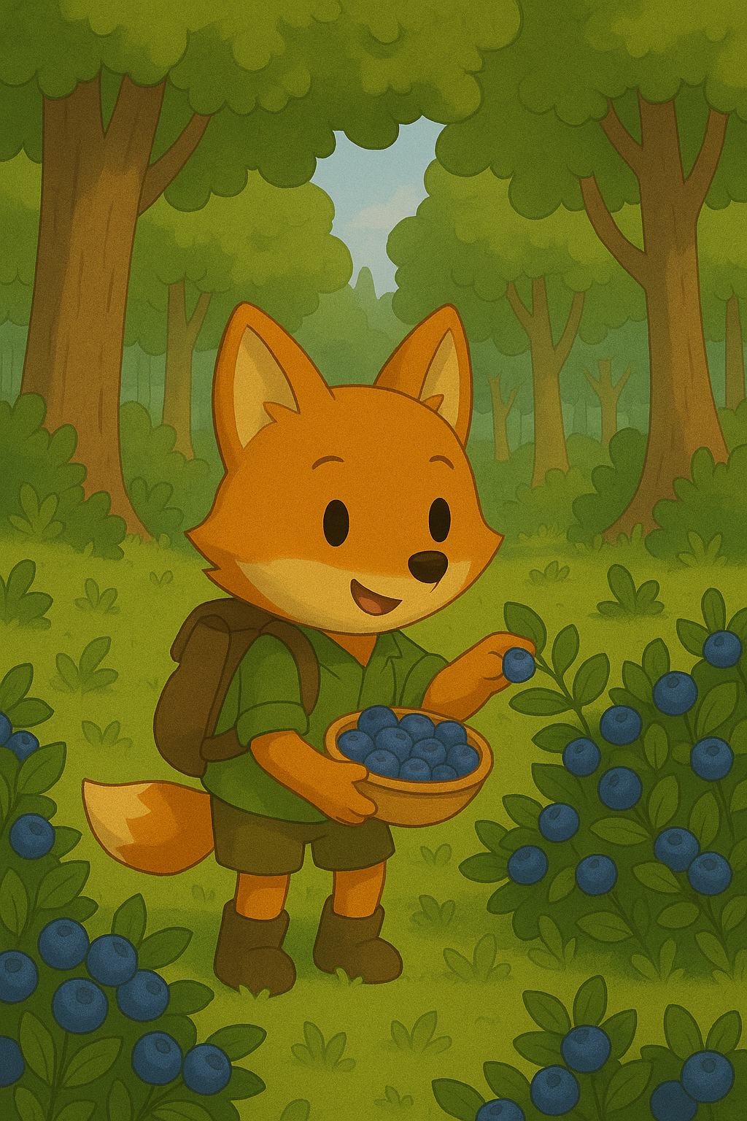
﻿﻿Unity
Collectibles & Quest Tracking
Dialog Interactions
Interaction with Objects and the environment

Slide 7
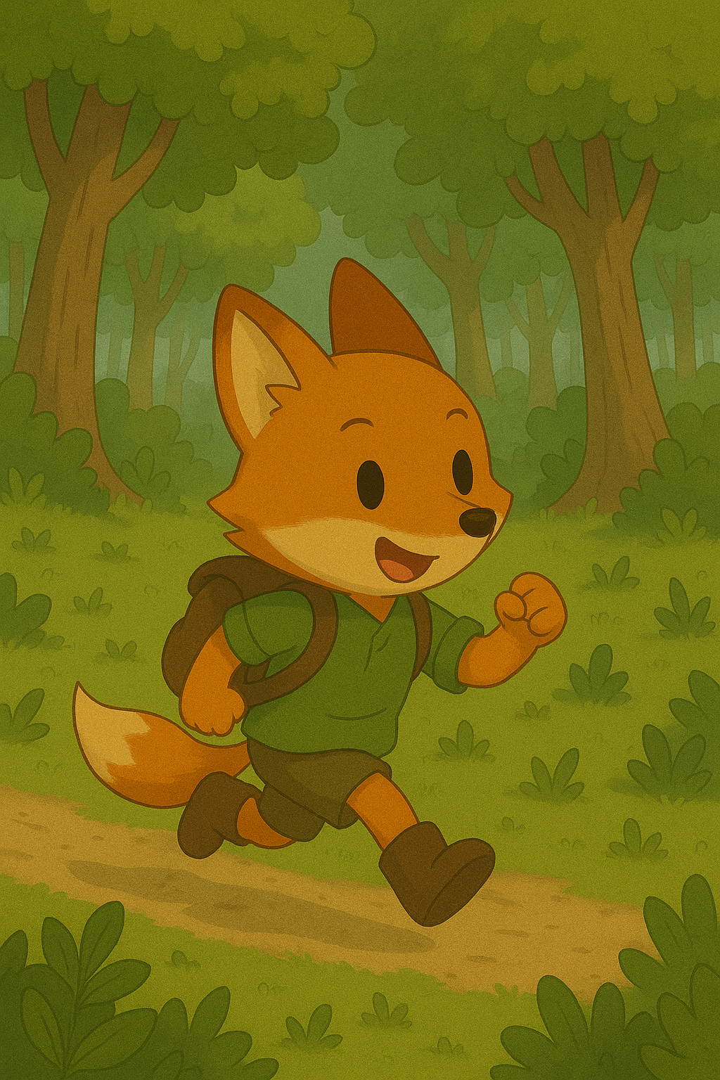
﻿﻿C#
Movement
Jump
Talking
Interaction with Items

Slide 8
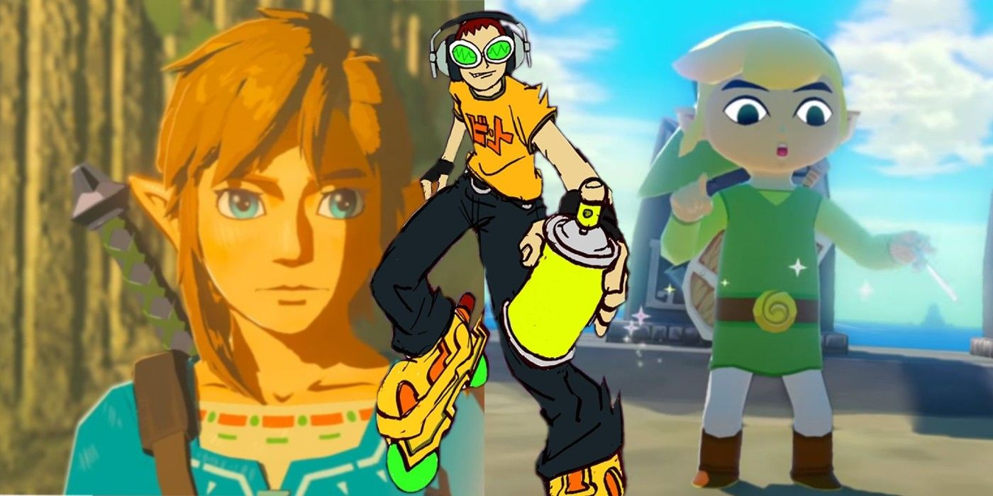
Theory of CG
Pixel Shader
Cellshaded/Unlit Look
https://screenrant.com/cel-shaded-games-zelda-wind-waker-borderlands-hades/

Slide 9
﻿﻿Time plan of the 2 weeks
Day 9-12
Day 1-2
Finalizing the concept, improving on storyline
Day 3-5
Implement Player Controls and Interactions
Day 6-8
Collectibles & 3D – Models & Audio implementation
Start Playtesting, fix Bugs, improve Game
Finish up, buffer for problems along the way
Day 13-14

